Slide 1
BLOOD CHAIN AND SUPPLY MANAGEMENT
RED CROSS BLOOD MANAGEMENT SYSTEM

Slide 2
Purpose
The shortage of blood can occur at anytime, anywhere and in some cases, it also happens that some of the hospitals do ‘not have their own blood bank or most of the time there is deficiency of blood or no match of the required blood group is found.
Purpose of this application is to simplify and automate the process of searching for blood in case of emergency and maintain the records of blood donors, recipients and stock availability in the blood bank.

Slide 3
Problem Statement
Our application mainly deals with following major problems of current scenario:
•Manual approach
Currently, major blood banks follow the manual approach for processing blood. With the manual approach, there are problems in managing bloodstock, blood donor details, and request details.
•The communication gap between donor and recipient
Due to the lack of communication between the blood donors and the blood recipients, most of the patients in need of blood do not get the blood on time. So, it is required to make synchronization between the blood donors, recipient, and the blood banks. This improper management of blood leads to wastage of the available blood inventory and black marketing.

Slide 4
Key functionalities of project
Functionalities provided by the applications are as follows:
• The application provides the login for admin, blood bank, Lab assistant, donor and recipient for searching, viewing and request blood information.
• Provides search facilities based on various factors like geo location, blood group and details of donor and recipient.
• Track availability of blood and information of different blood group.
• Show information of blood bank, donor and recipient.

Slide 5
Additional features
• Notification through the mail will be sent to a donor if a user will request for blood.
• Immediate blood can be provided to the user in case of an emergency. The application will find the nearest blood bank or donor from where blood can be provided to the user who is in need.

Slide 6
Entities involved in project
Admin: Admin can manage credential and information of blood bank, lab.
User: Application can store the details of the user. Basically, a user can be of two types.
Donor: Application will store the information of the user such that in case of requirement of blood, blood bank or recipient can directly contact them.
Recipient: Through the application, a recipient can directly contact to the blood bank if bloodstock is available or with the donor of the required blood group.
Hospital: Hospital basically manages blood stock availability and store details of donor and recipient.
Lab Assistant: Lab Assistant validates the blood stock.

Slide 7
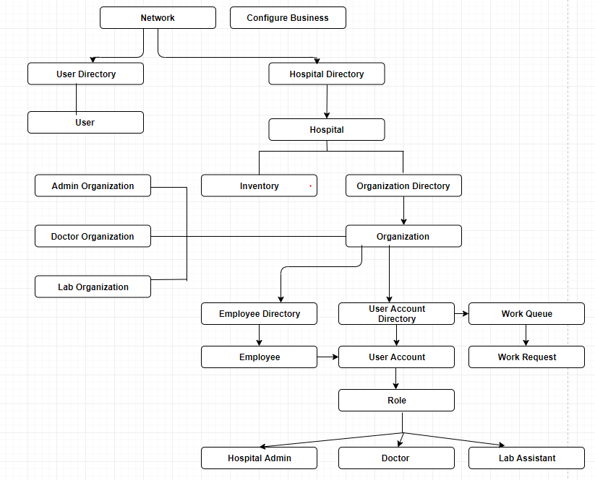
Object Model

Slide 8
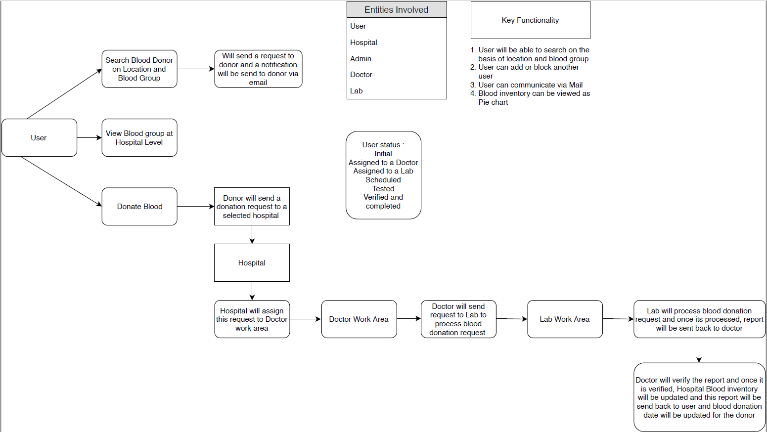
Work-flow Model

Slide 9
Identified Actors
In our Blood Bank Management System, the actors would be:
System Admin: This actor is the principle user who can create new hospitals and can manage their admins.
Admin: This actor will majorly govern the different organizations of hospital which includes Doctor Organization, Lab Organization and inventory.
Doctor: This actor will validate and process the requests raised by the users (donor and recipients) and forward that to the Lab Organization.
Lab Assistant: This actor will be responsible for appointment scheduling.
User: This actor plays the important role in the system. There are two types of user registered in the system, Donor and Recipient
Recipient: Recipient can raise a blood request in the system, in case of any urgency.
Donor: Donor can donate blood to the recipient once the request has been confirmed by the hospital.

Slide 10
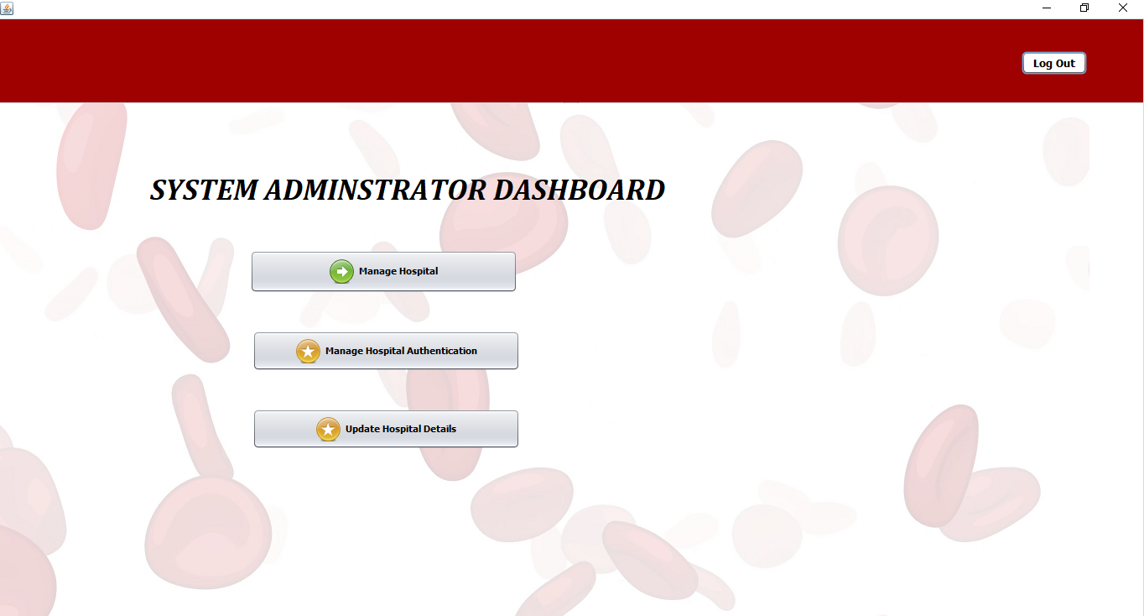
System Admin Functionalities
System Admin has authority to manage Hospitals and their corresponding admins.

Slide 11
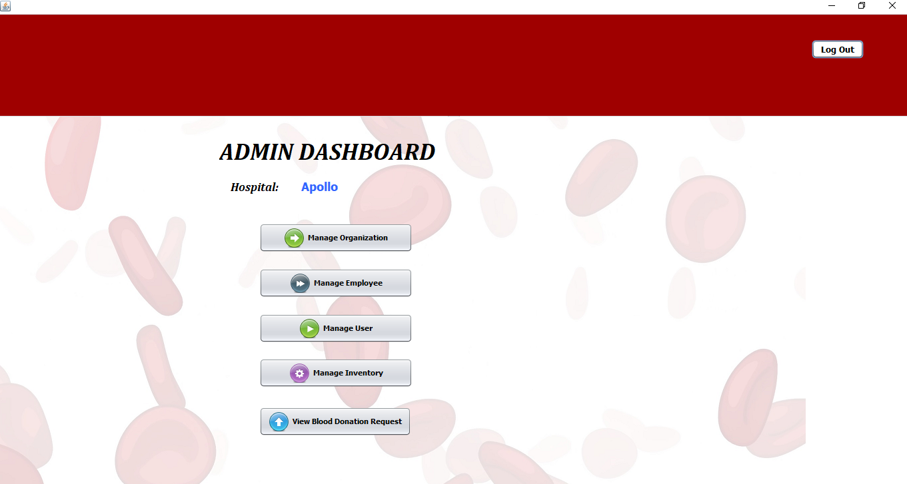
Hospital Admin Functionalities
Hospital Admin has authority to manage different organizations of a hospital i.e. Doctor Organization and Lab Organization.

Slide 12
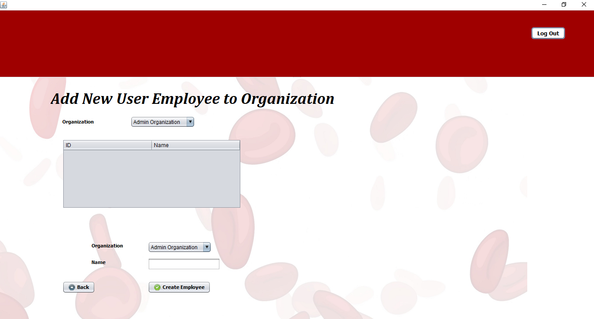
Hospital Admin Functionalities (Continue)
Hospital Admin can create employees and can assign roles to them.

Slide 13
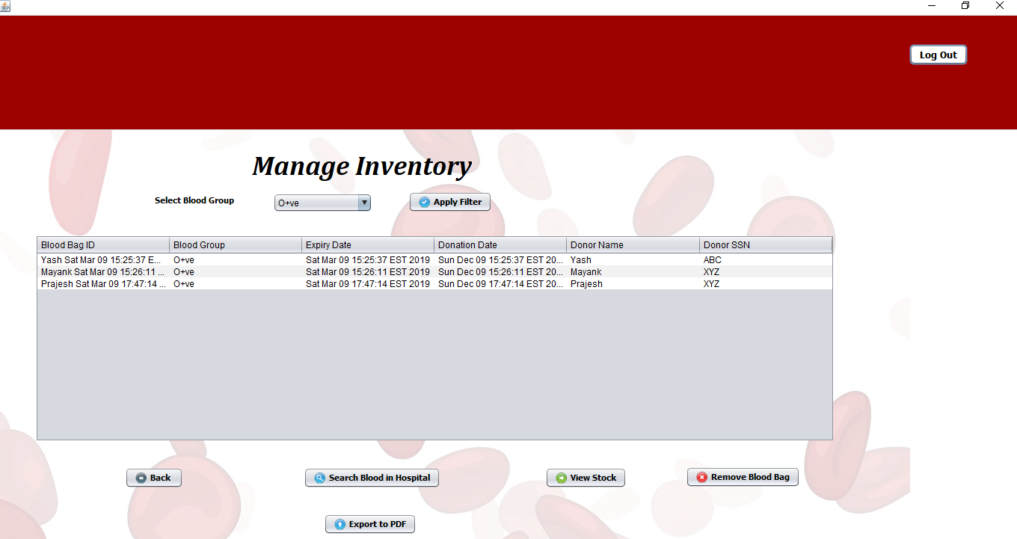
Hospital Admin Functionalities (Continue)
Hospital Admin can also manage blood inventory and can communicate with other Hospitals in case of any blood requirements.

Slide 14
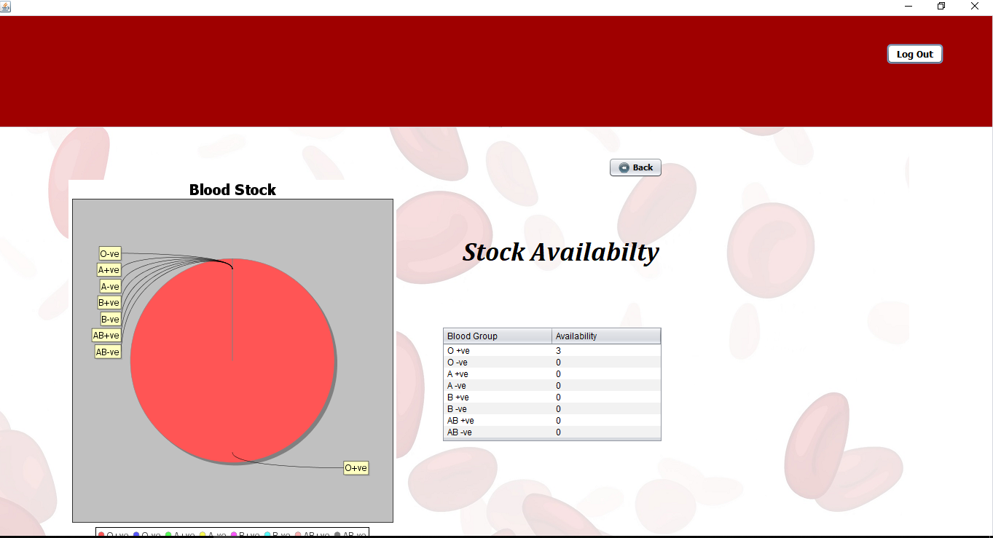
Hospital Admin Functionalities (Continue)
Hospital Admin can also view blood stock.

Slide 15
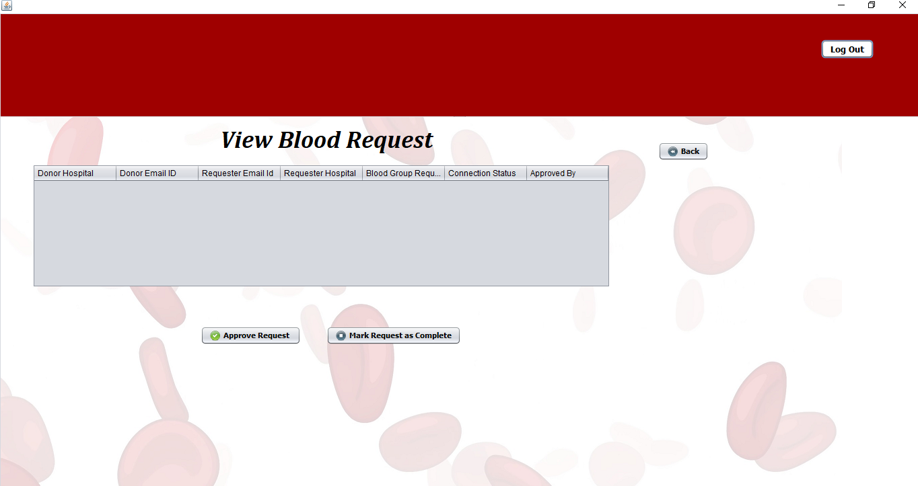
Hospital Admin Functionalities (Continue)
Hospital Admin can also manage the blood donation requests.

Slide 16
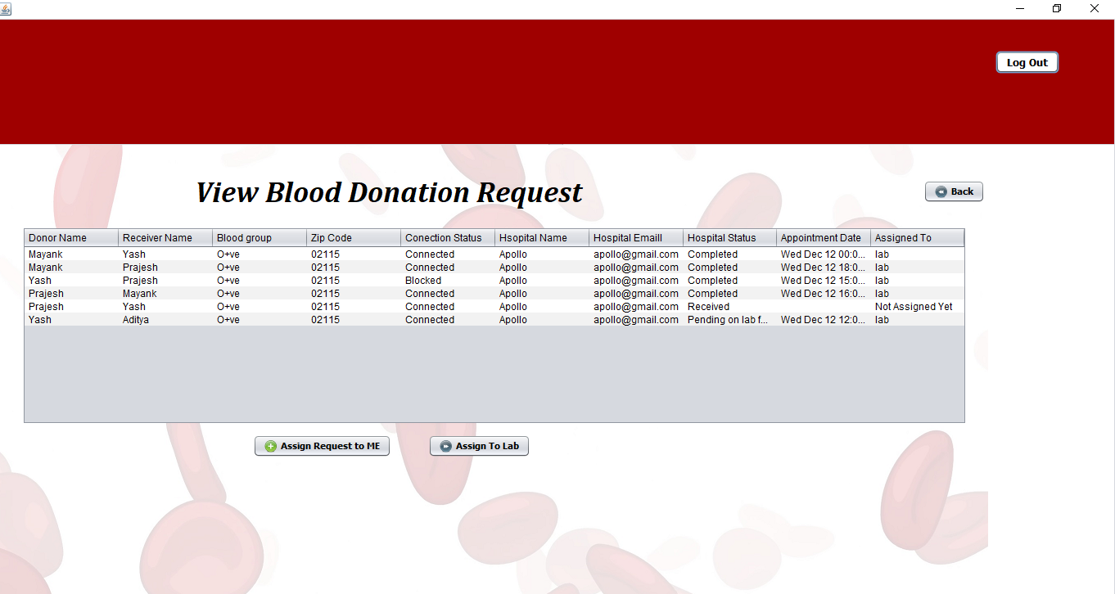
Doctor Functionalities
Any blood donation request queued in the hospital will be visible to the doctor organization and any doctor can assign that request to himself and redirect it to the lab.

Slide 17
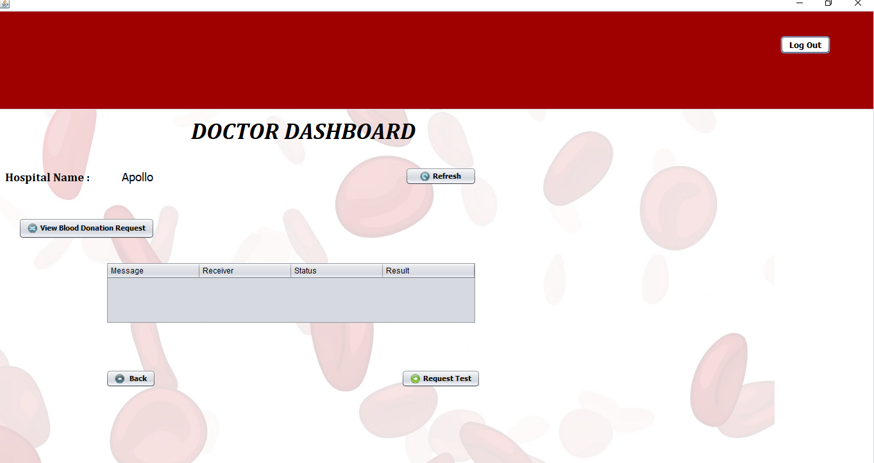
Doctor Functionalities (continue)
Doctor can send a test request to the lab corresponding to a user.

Slide 18
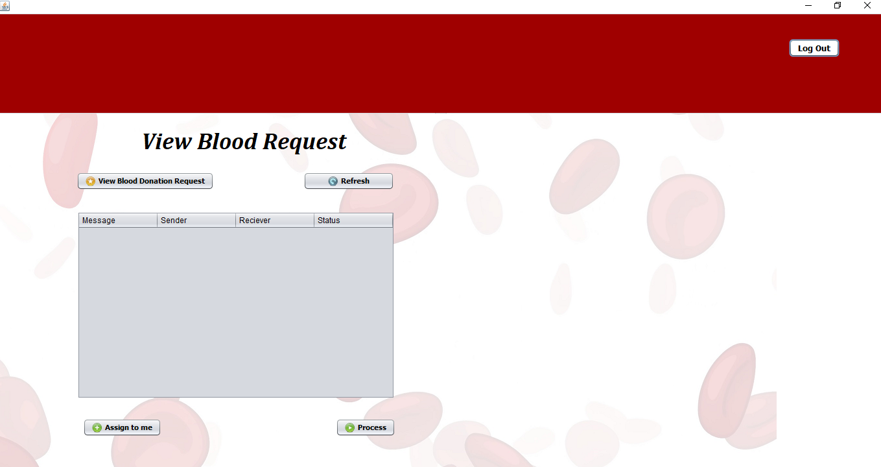
Lab Assistant Functionalities
Lab Assistant can respond to the test request made by the doctor.

Slide 19
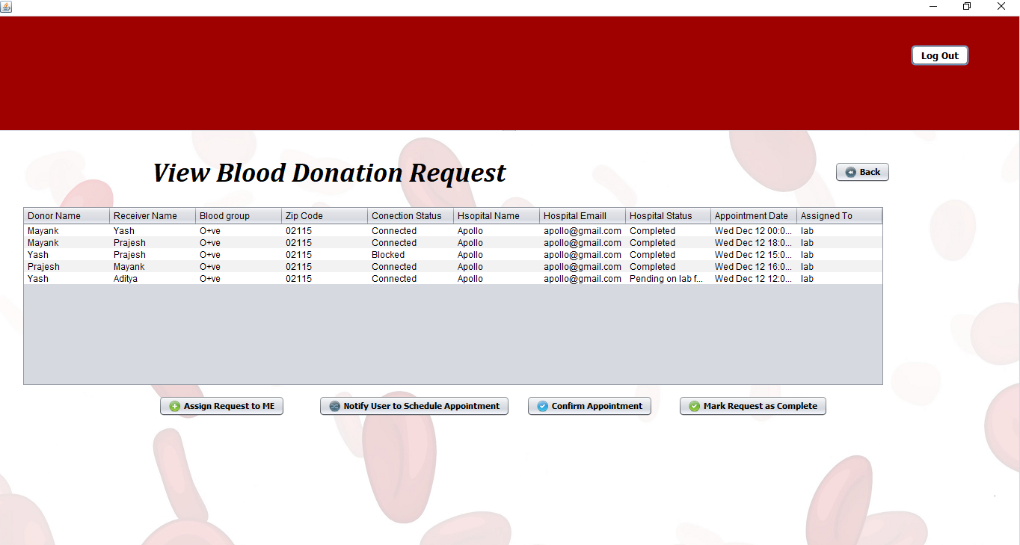
Lab Assistant Functionalities (Continue)
Lab Assistant can schedule appointment of the user for blood donation request.

Slide 20
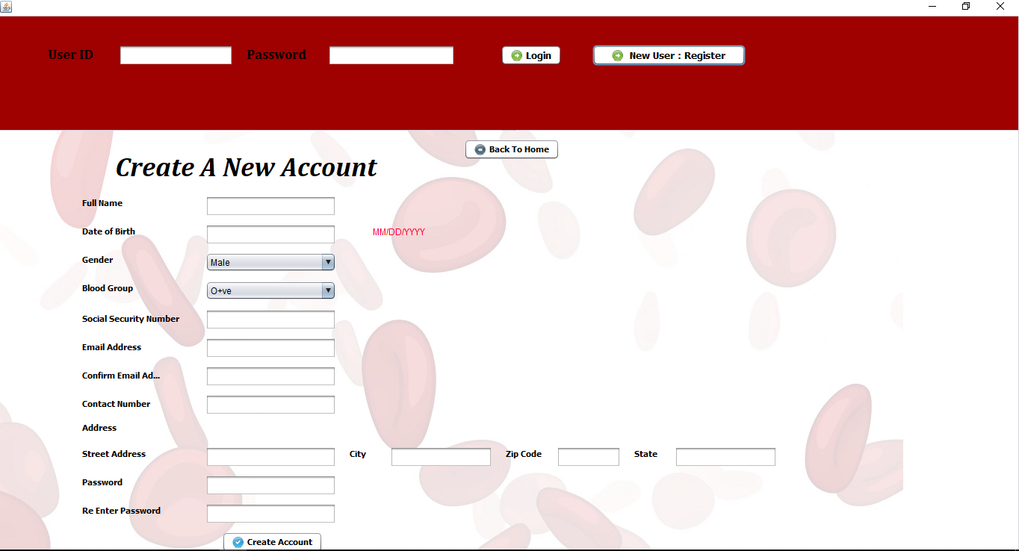
User Functionalities
Either of the users, Donor or Recipients can register to the system.

Slide 21
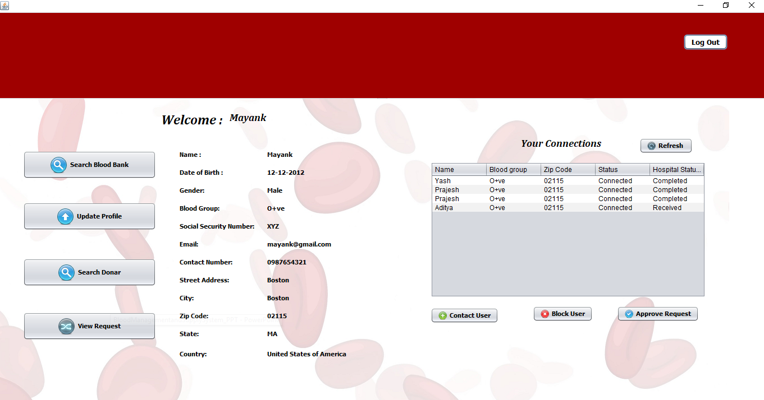
User Functionalities (Continue)
User can contact other users whose status is connected, Users Can block or approve the request of other users whose status is pending.

Slide 22
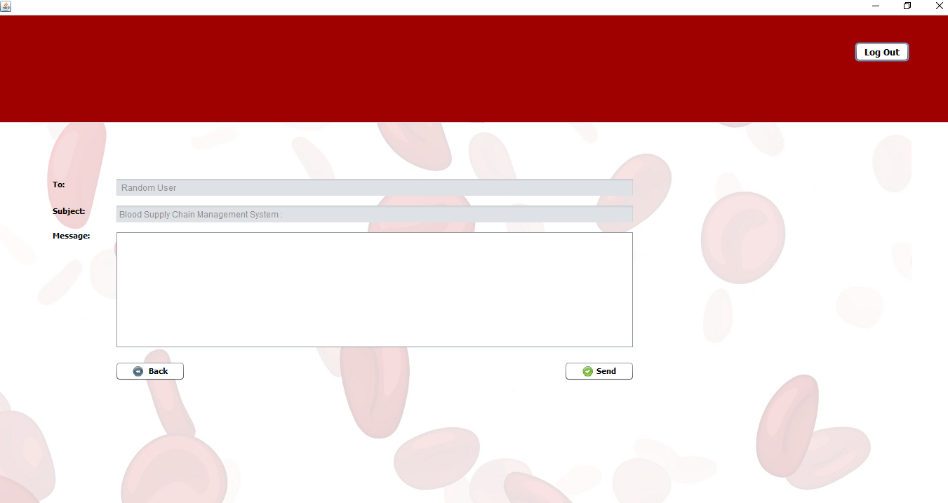
User Functionalities (Continue)
User can contact other users whose status is connected, Users Can block or approve the request of other users whose status is pending.

Slide 23
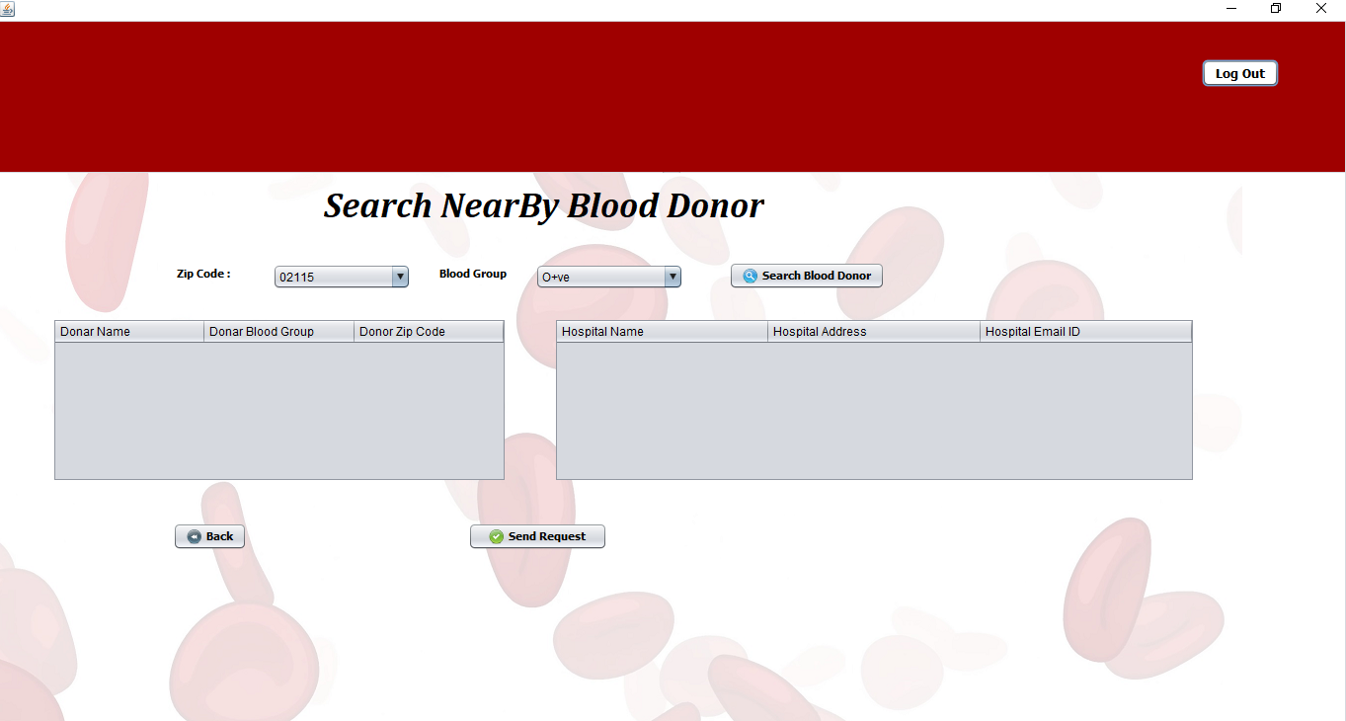
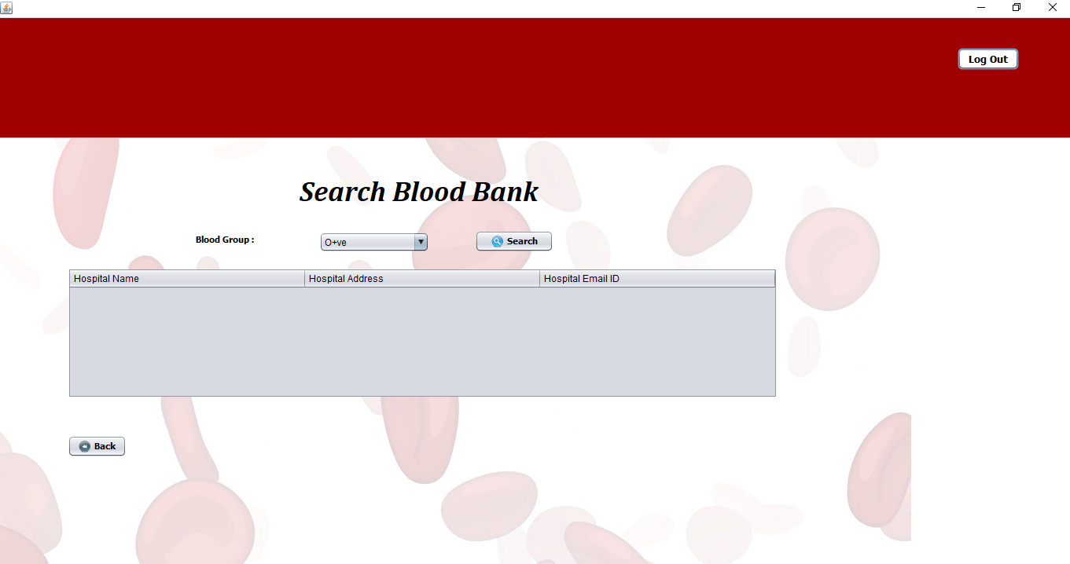
User Functionalities (Continue)
Recipients can search for Donors and Hospitals by selecting blood group and zip code.

Slide 24
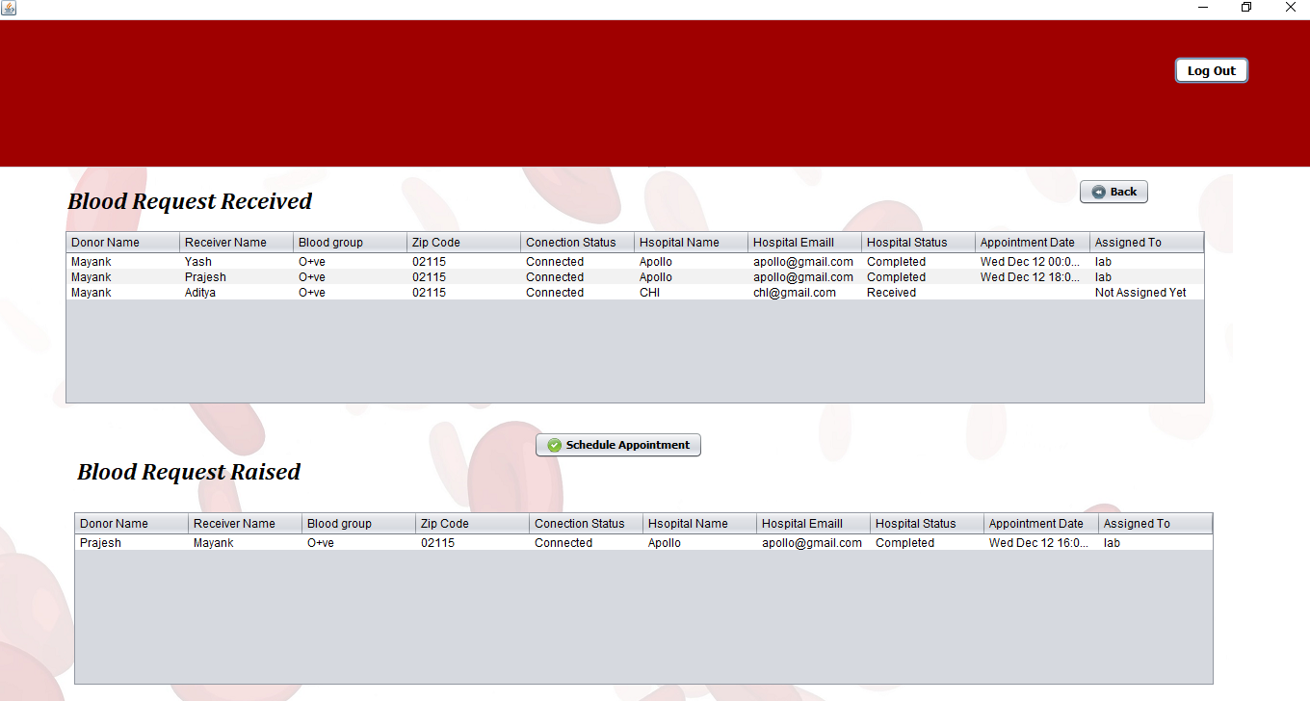
User Functionalities (Continue)
User can view raised blood requests and received blood requests on this page. User can also schedule appointments for the received request whose status is schedule appointment.

Slide 25
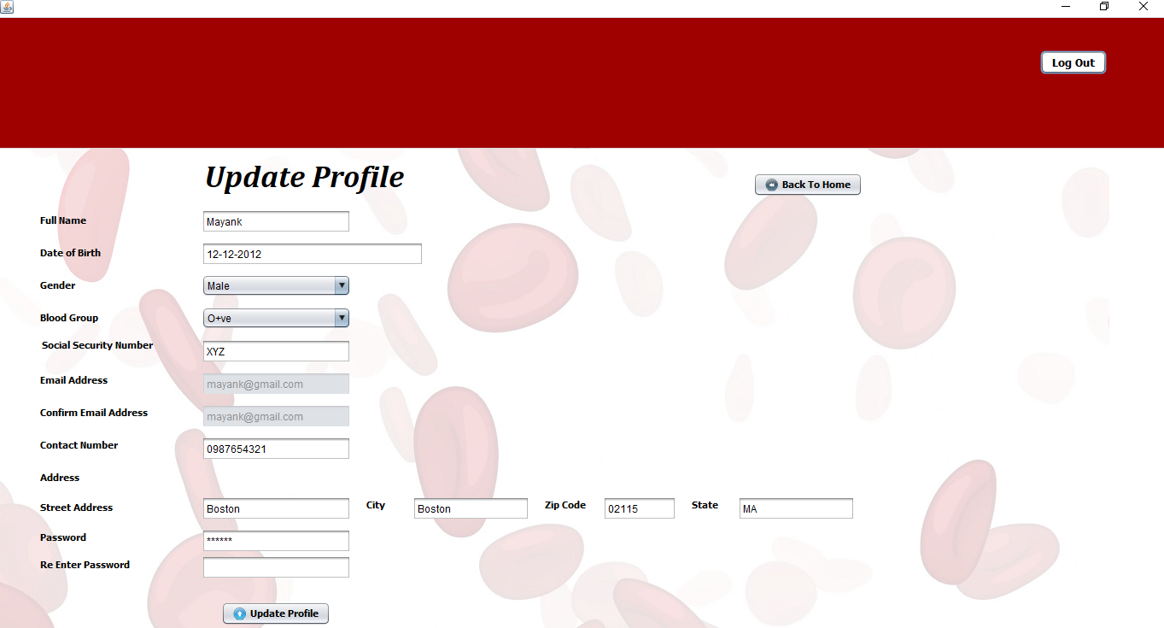
User Functionalities (Continue)
Users can also update their profile.

Slide 26
Thank You…!!

